Slide 1
HTML Fundamentals
WORKING WITH HTML DOCUMENTS

Slide 2
Overview
Understanding HTML
How browsers use HTML Dissecting an HTML document

Slide 3
HTML Has Aged Well
HTML Then
Research documents Sharing reports
Linking to related research Displaying experimental data Charts, graphs, and simple pictures
HTML Now
Storefronts, applications, files/photos Interactive interfaces
Graphically rich

Slide 4
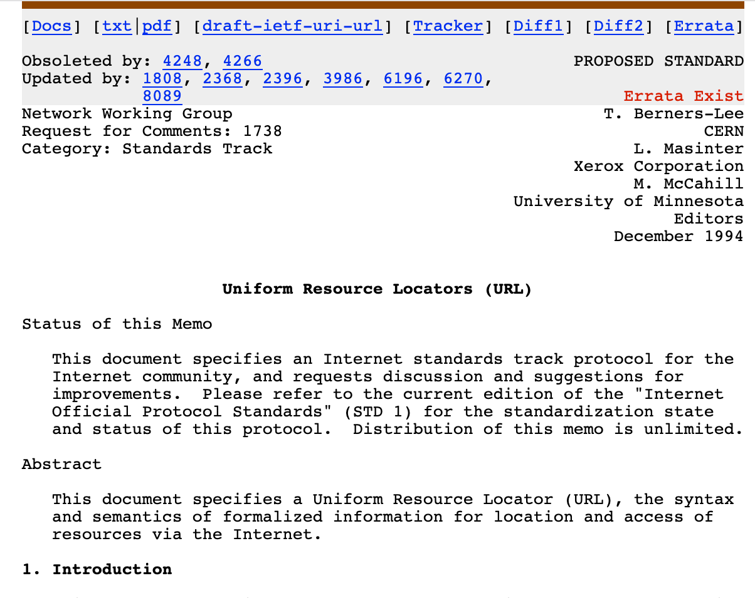

HTML Has Aged Well
HTML Then
HTML Now

Slide 5


HTML Documents
HTML is a markup language
Text in the document is “marked up” Markup is not displayed
Browsers interpret the markup

Slide 6




Understanding HTML
Hypertext Markup Language
Hypertext Transport Protocol
Universal Resource Identifier
Universal Resource Locator

Slide 7
<!DOCTYPE HTML>
<!DOCTYPE HTML PUBLIC
"-//W3C//DTD HTML 4.01//EN“
"http://www.w3.org/TR/html4/strict.dtd">
HTML Documents: Part 1
The DOCTYPE indicates the standards compliance or version of the document

Slide 8
</html>
<!DOCTYPE | html>
<html> … page | content | here…
HTML Documents: Part 2
The HTML element acts as the root of the document

Slide 9
<head>
<title>HTML Fundamentals</title>
<meta name="viewport" content="width=device-width, initial-scale=1">
<link rel="stylesheet" type="text/css" href="main.css" />
</head>
HTML Documents: Part 3
The HEAD element contains document metadata

Slide 10
<html>
<head> </head>
<body>
… page content ACTUALLY goes here …
</body>
</html>
HTML Documents: Part 4
The BODY contains the content to be displayed

Slide 11
<head>
<title>
<meta>
<script>
<style>
<link>
<base>

Slide 12
<body>
Text
Lists
Links
Tables
Images

Slide 13
Summary
HTML was created to share content
HTML is interpreted by browsers HTML and HTTP support the web HTML documents are structured data

